Slide 1
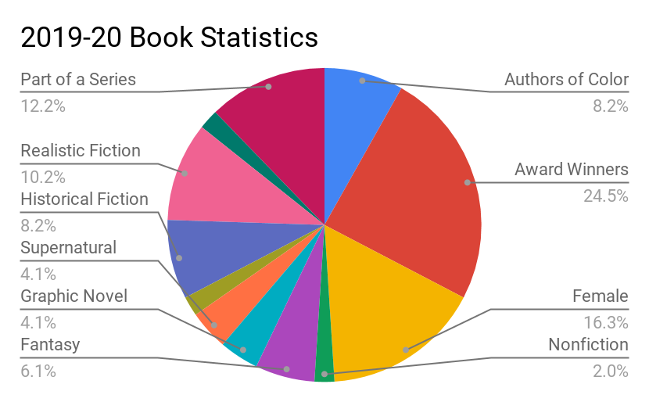
Idaho Battle of the Books
Middle Grades Division (6-9)
2019-2020
Selected Titles
Awkward by Svetlana Chmakova
Chains by Laurie Halse Anderson
The Epic Fail of Arturo Zamora by Pablo Cartaya
Finding Gobi by Dion Leonard
Frogkisser! by Garth Nix
The Hobbit by J.R.R. Tolkien
Inside Out and Back Again by Thanhha Lai
Rebel of the Sands by Alwyn Hamilton
Restart by Gordon Korman
Roller Girl by Victoria Jamieson
Salt to the Sea by Ruta Sepetys
The Screaming Staircase by Jonathan Stroud
The Skeleton Tree by Iain Lawrence
Some Kind of Courage by Dan Gemeinhart
Steelheart by Brandon Sanderson
Wolf by Wolf by Ryan Graudin
4
Members per team
9
Months to Read
16
Books to Enjoy
1
Trophy to Win
5,084
The number of pages students who participate in this year’s Idaho Battle of the Books will have read!
This year’s selected books:
range in lexile from 440 to 1000.
range in length from 208 to 448 pages
Include protagonists who represent various races, religions, cultures, and socio economic situations

Slide 2
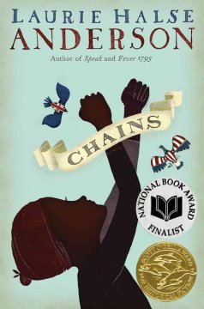
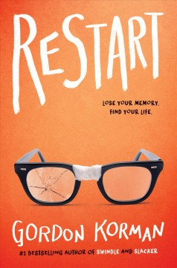
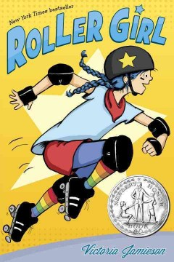
2019-20 Book Blurbs
Set in New York City at the beginning of the American Revolution, Chains addresses the price of freedom both for a nation and for individuals. Isabel is a slave and was sold with her five-year-old sister to a cruel Loyalist family. She has hopes of finding a way to freedom and becomes a spy for the rebels, but soon realizes that it is difficult to trust anyone.
When David was six, an unexplained explosion in the sky caused perpetual darkness and ordinary people to gain supernatural powers. One of these Epics, Steelheart, kills David’s father and leaves him orphaned. Ten years later, David joins the Reckoners, a shadowy group of ordinary humans who strive to eliminate all Epics. Will David finally have his revenge?
When a middle school bully suffers amnesia after a bad fall, it gives him the chance to start fresh, but rebuilding his life is an uphill battle when everyone else still remembers the sins of his past. 8th grader, Chase Ambrose, struggles with who he was, who he wants to become, and how that affects those around him. In this compelling and sometimes humorous tale of nature and identity, Korman offers an intriguing exploration of the potential for redemption.
It’s 1890 in Washington State, and 12 year old Joseph Johnson’s beloved horse, Sarah, has been sold by the unscrupulous alcoholic who took him in after his father’s death. With an unshakable moral compass instilled in him by his parents, he sets off to get her back. In the process, he overcomes relentless disasters and crises, encounters virtuous and dubious characters, and perform some good deeds.
A story based on the author's childhood experiences. Hà is 10 when Saigon falls and her family flees Vietnam. First on a ship, then in two refugee camps, and then finally in Alabama, she and her family struggle to fit in and make a home. Told in verse, each passage is given a date so readers can easily follow the progression of time. Even through her frustration with her new life, her voice is full of humor and hope.
Almost-middle-schooler Astrid just isn’t interested in the kinds of things everyone else is. Her BFF Nicole likes boys and ballet and the color pink, but Astrid’s new obsession is tough, fast-paced Roller Derby. While learning the game, Astrid learns how to be a friend and, maybe, that not all friendships are forever. A touching look at the ups and downs of following one’s dreams, in addition to introducing readers to a relatively unknown sport.
All book blurbs above have been harvested from NoveList Plus at LiLI.org.

